Slide 1
Radial Velocity Curves
Experimenting with Radial Velocity curves using Jupyter Notebook
Exeter University Work Experience

Slide 2
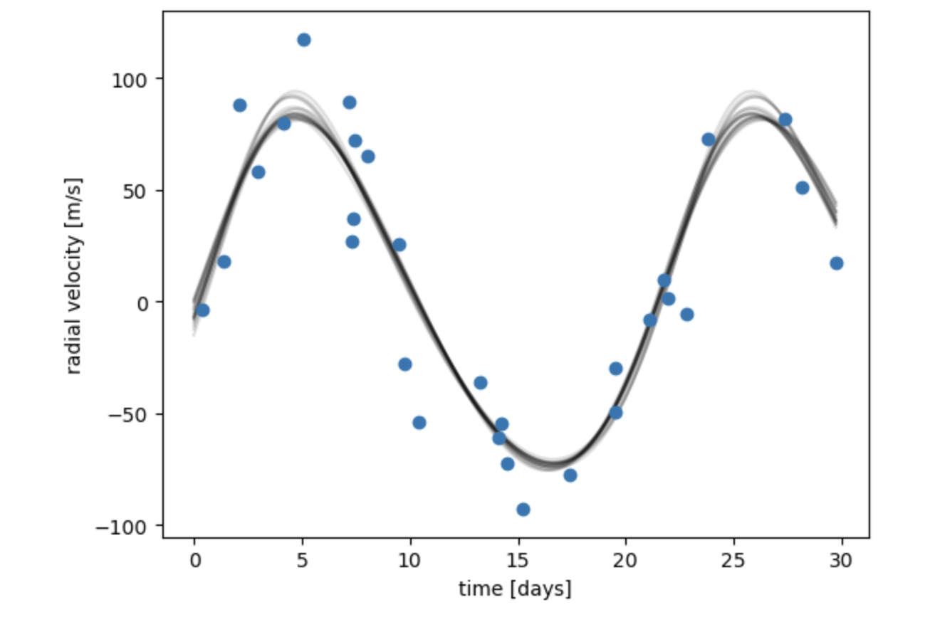
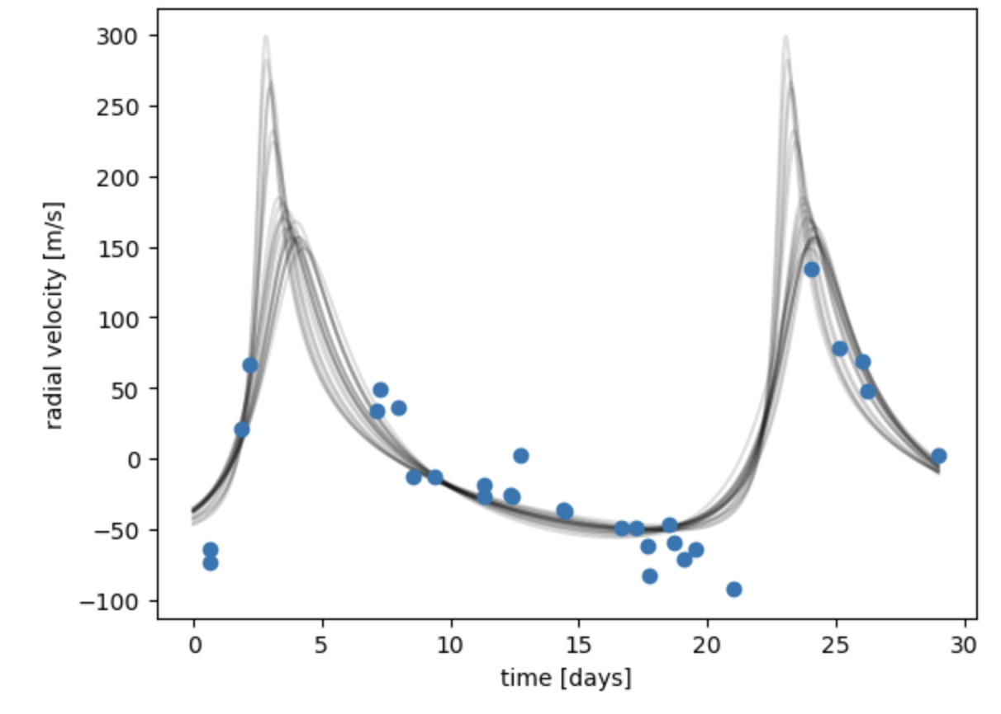
Orbital Eccentricity
High Eccentricity
Eccentricity is a measure of the amount an elliptical orbit deviates from its center.
High eccentricity
e=1
Low eccentricity
e<1
Low Eccentricity
Star
Orbiting Planet

Slide 3
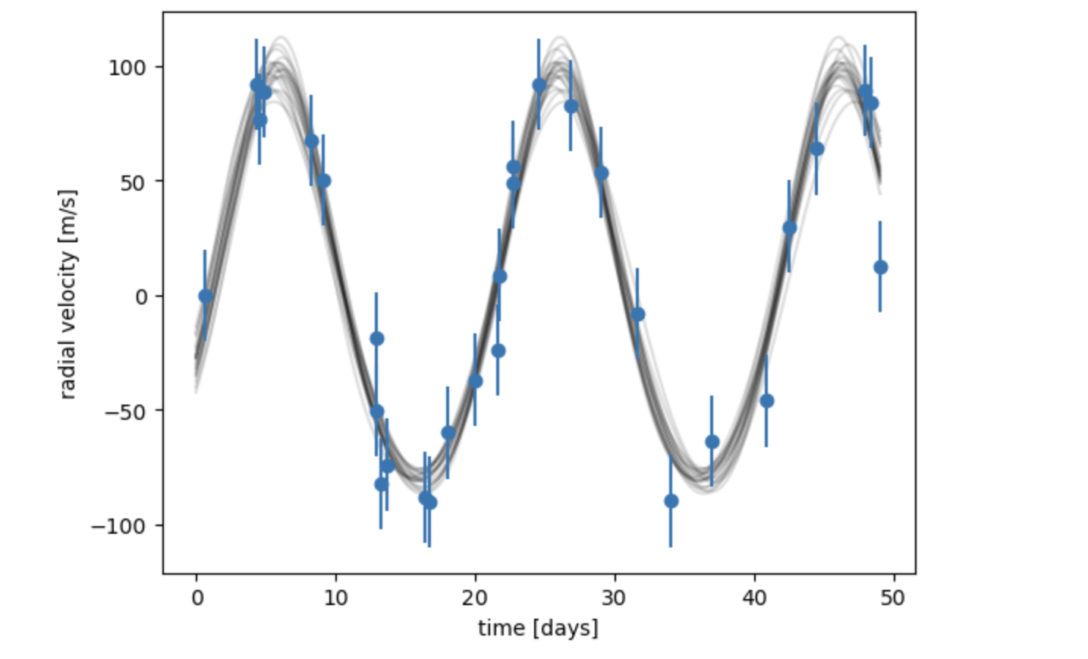
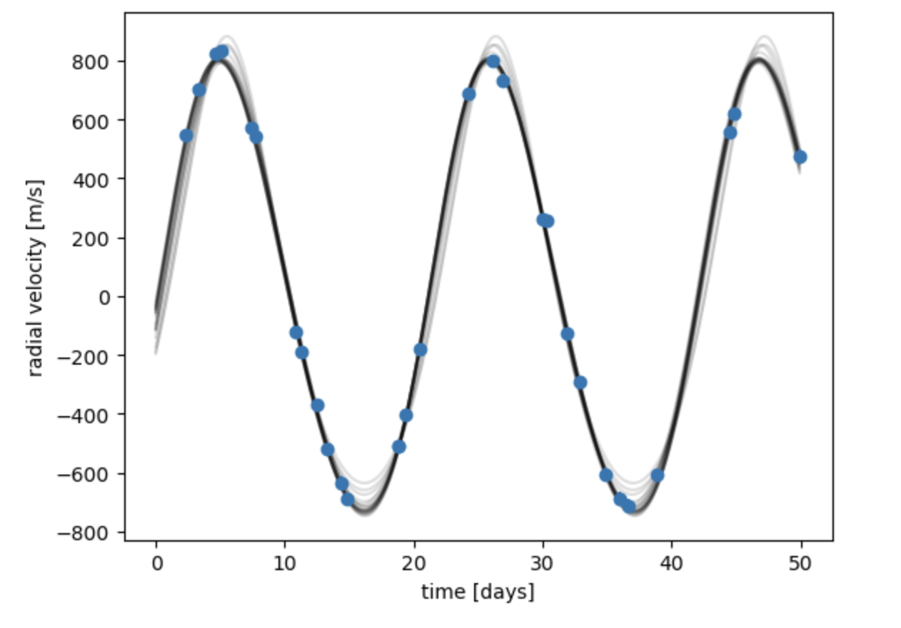
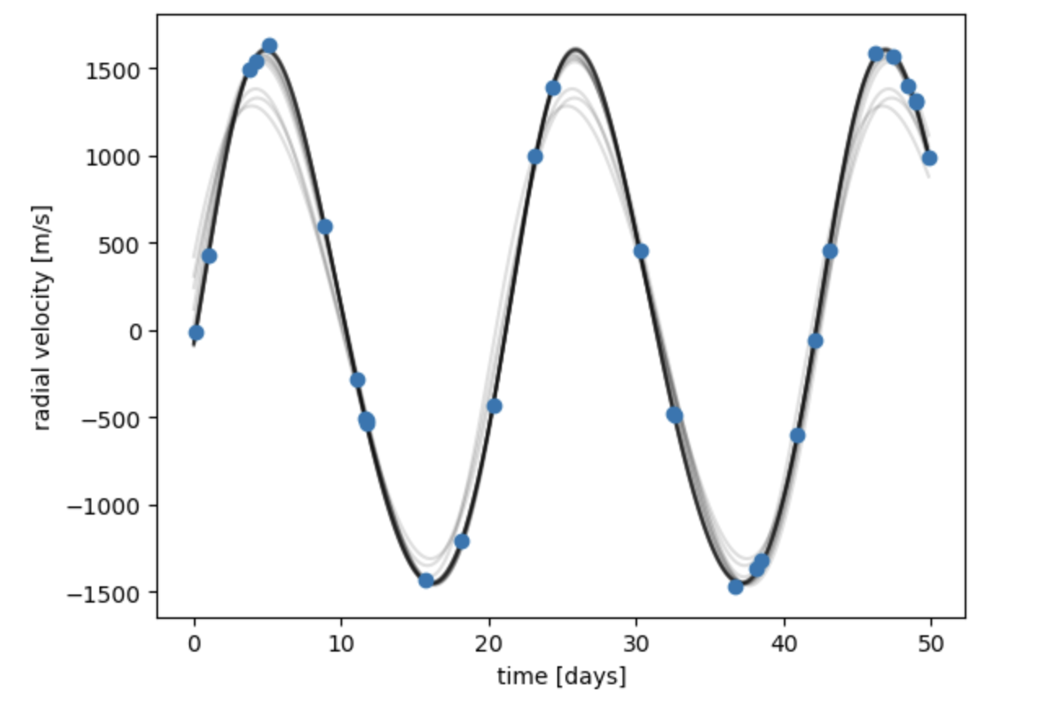
Increasing Planet Mass
One planet orbiting
Mass star=1
Mass planet=1e-3
P=21*60*60*24
h=0.05
k=0.05
N=30
Ms=1
Mp=10e-3
P=21*60*60*24
h=0.05
k=0.05
N=30
Ms=1
Mp=20e-3
P=21*60*60*24
h=0.05
k=0.05
N=30
Increasing planet mass increases the amplitude of the wave- radial velocity is increased.

Slide 4
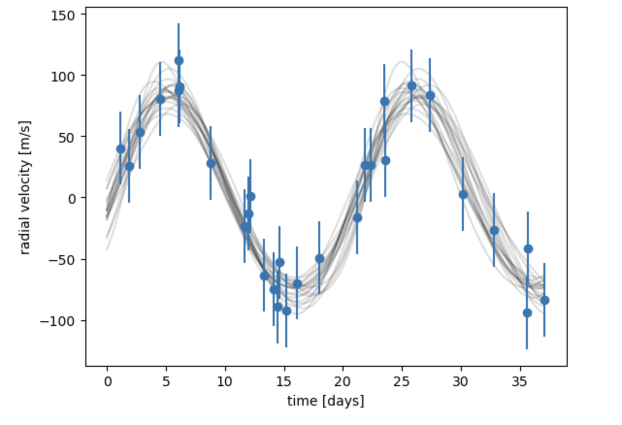
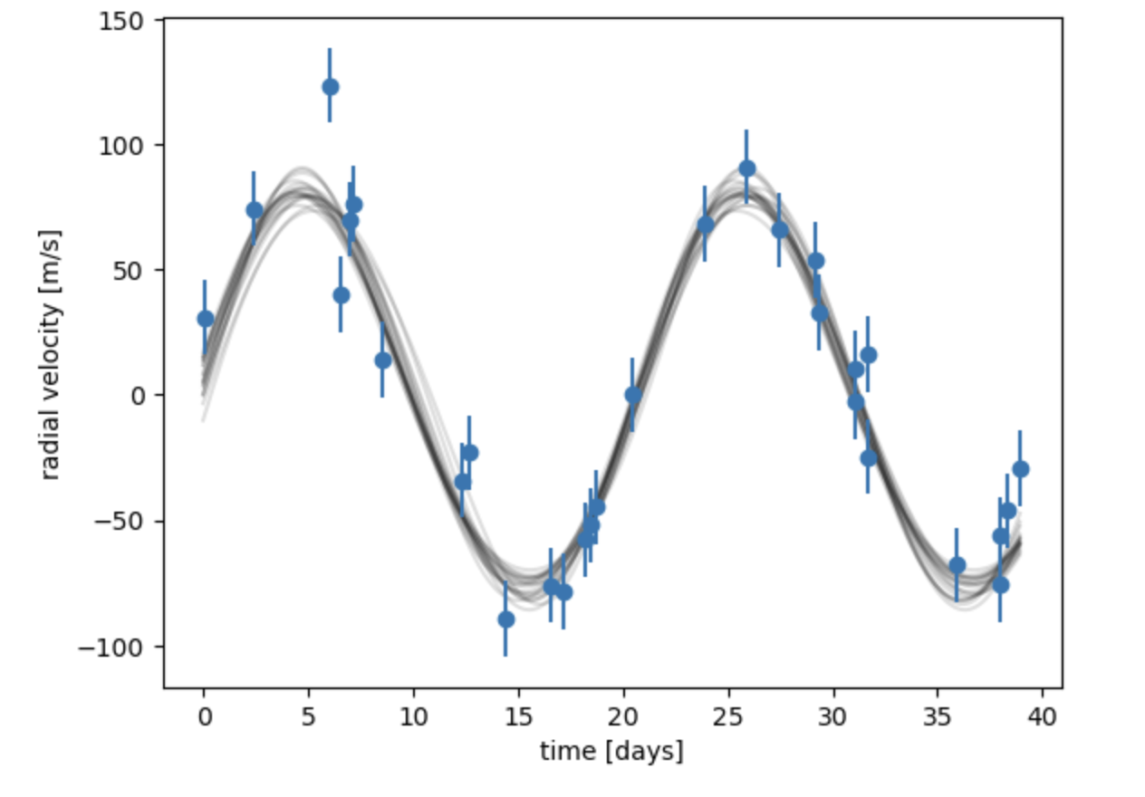
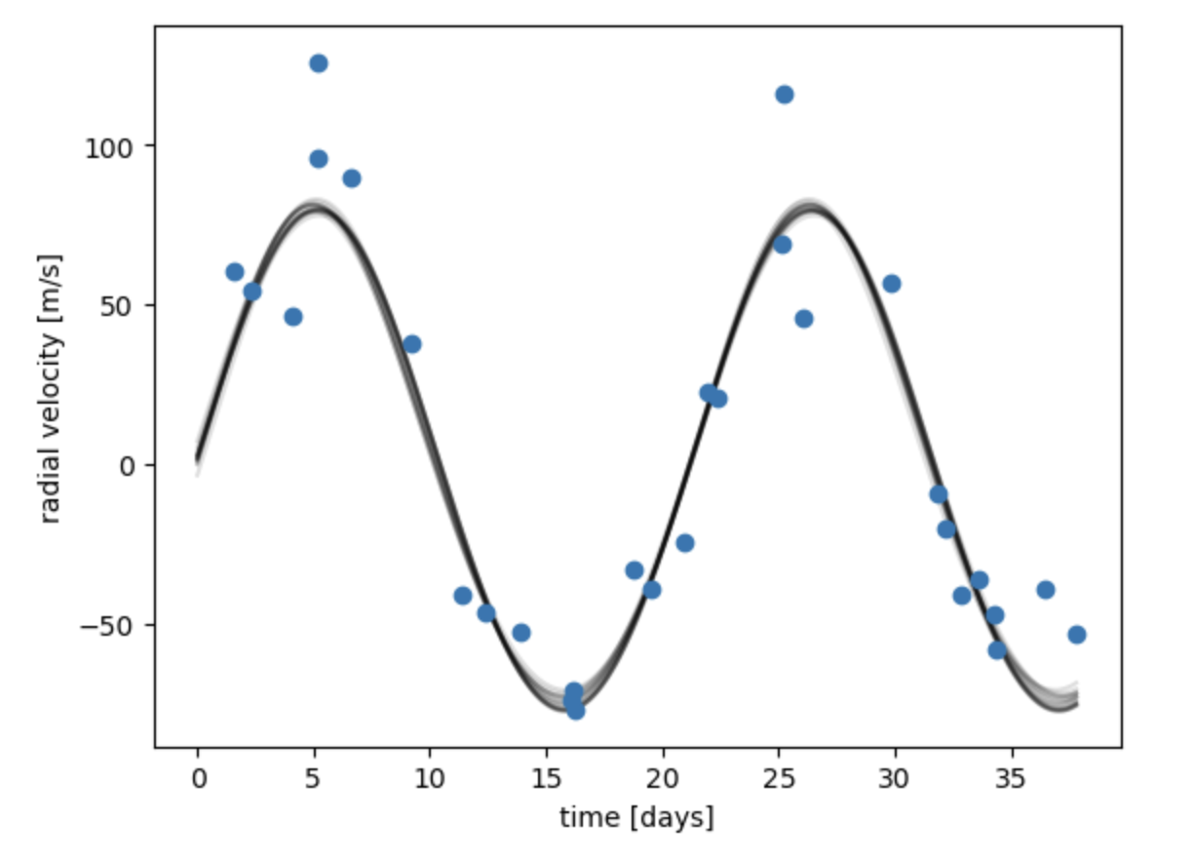
Decreasing Error interval
One planet orbiting
Ms=1
Mp=10e-3
P=21*60*60*24
h=0.05
k=0.05
N=30
Error=30
Noise=20
Ms=1
Mp=10e-3
P=21*60*60*24
h=0.05
k=0.05
N=30
Error=15
Noise=20
Ms=1
Mp=10e-3
P=21*60*60*24
h=0.05
k=0.05
N=30
Error=1
Noise=20
Decreasing the error interval forms a clearer wave.

Slide 5
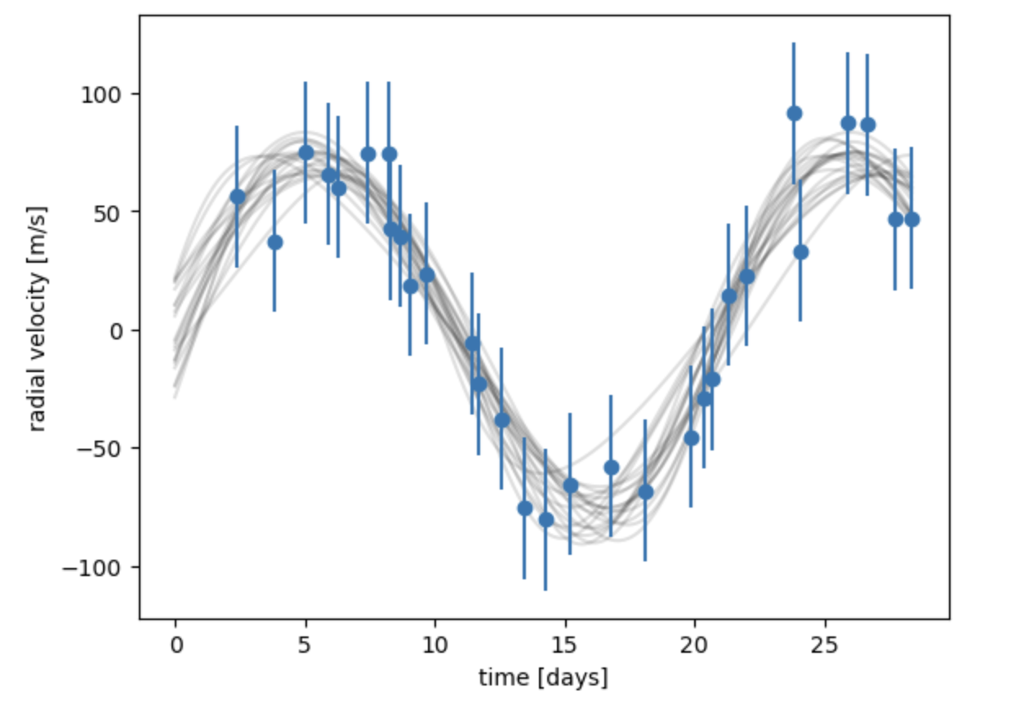
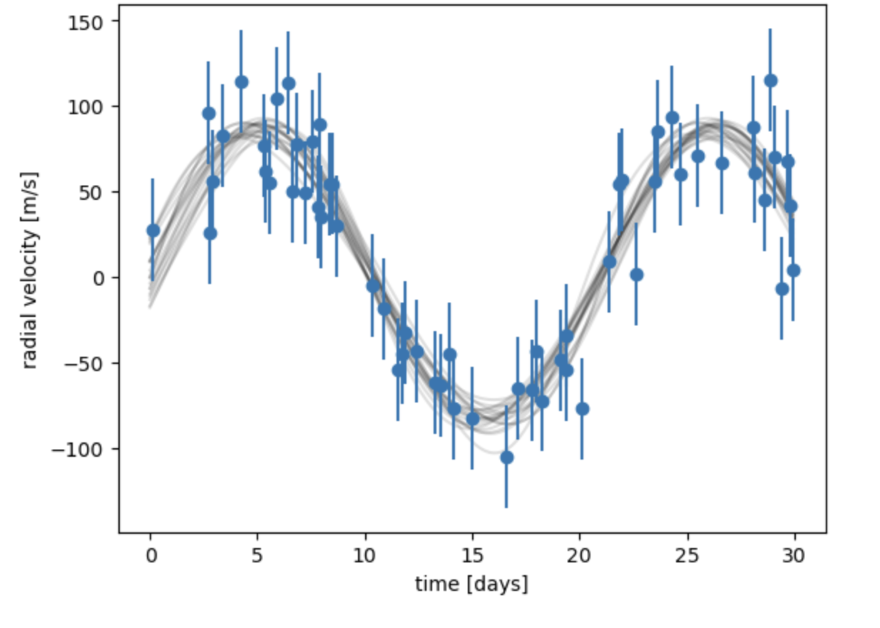
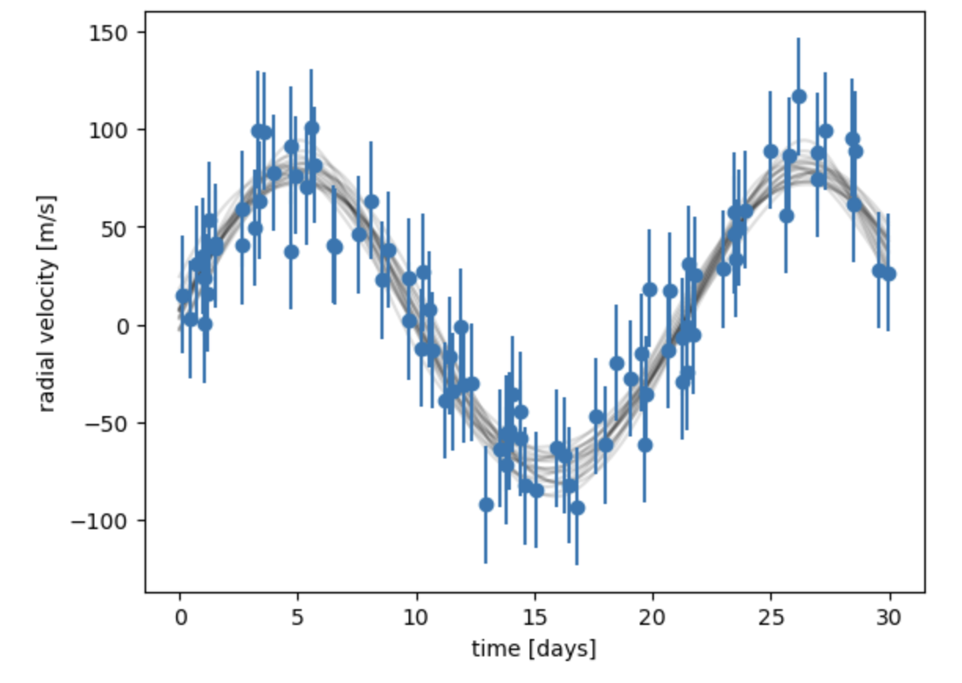
Increasing number of point values
One planet orbiting
Ms=1
Mp=10e-3
P=21*60*60*24
h=0.05
k=0.05
N=30
Error=30
Noise=20
Ms=1
Mp=10e-3
P=21*60*60*24
h=0.05
k=0.05
N=60
Error=30
Noise=20
Ms=1
Mp=10e-3
P=21*60*60*24
h=0.05
k=0.05
N=90
Error=30
Noise=20
Increasing the number of point values forms a more accurate curve.

Slide 6
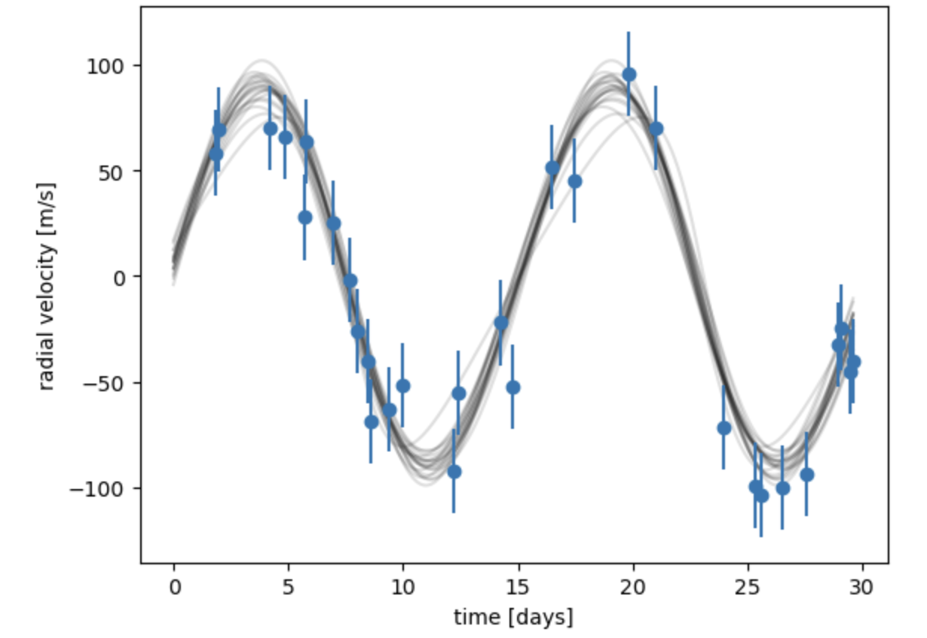
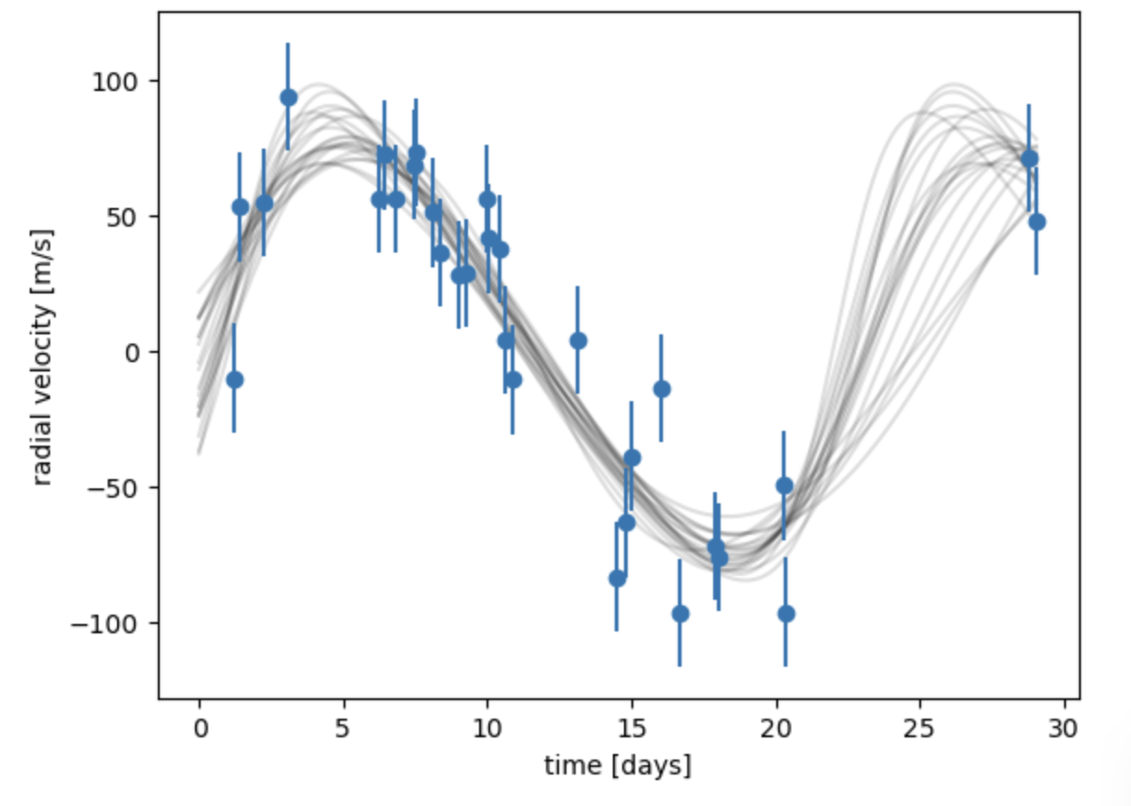
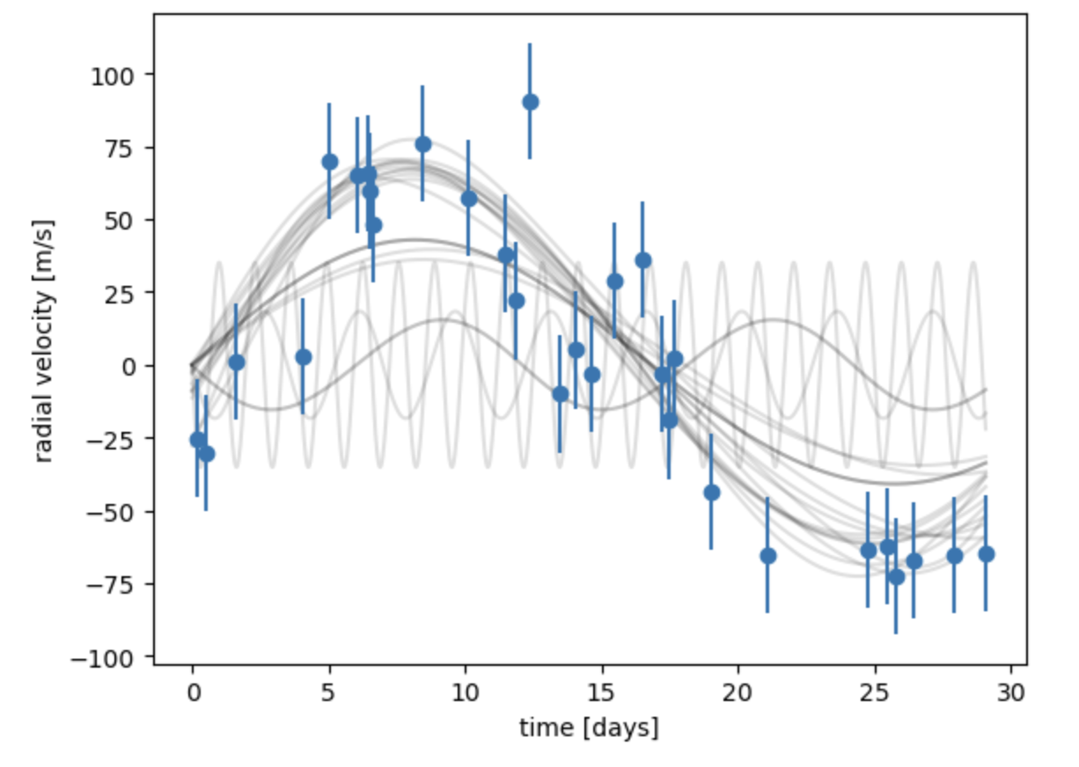
Increasing Orbital Period
One planet orbiting
Ms=1
Mp=10e-3
P=15*60*60*24
h=0.05
k=0.05
N=30
Error=30
Noise=20
Ms=1
Mp=10e-3
P=25*60*60*24
h=0.05
k=0.05
N=30
Error=30
Noise=20
Ms=1
Mp=10e-3
P=35*60*60*24
h=0.05
k=0.05
N=30
Error=30
Noise=20
Increasing orbital period decreases wavelength.

Slide 7
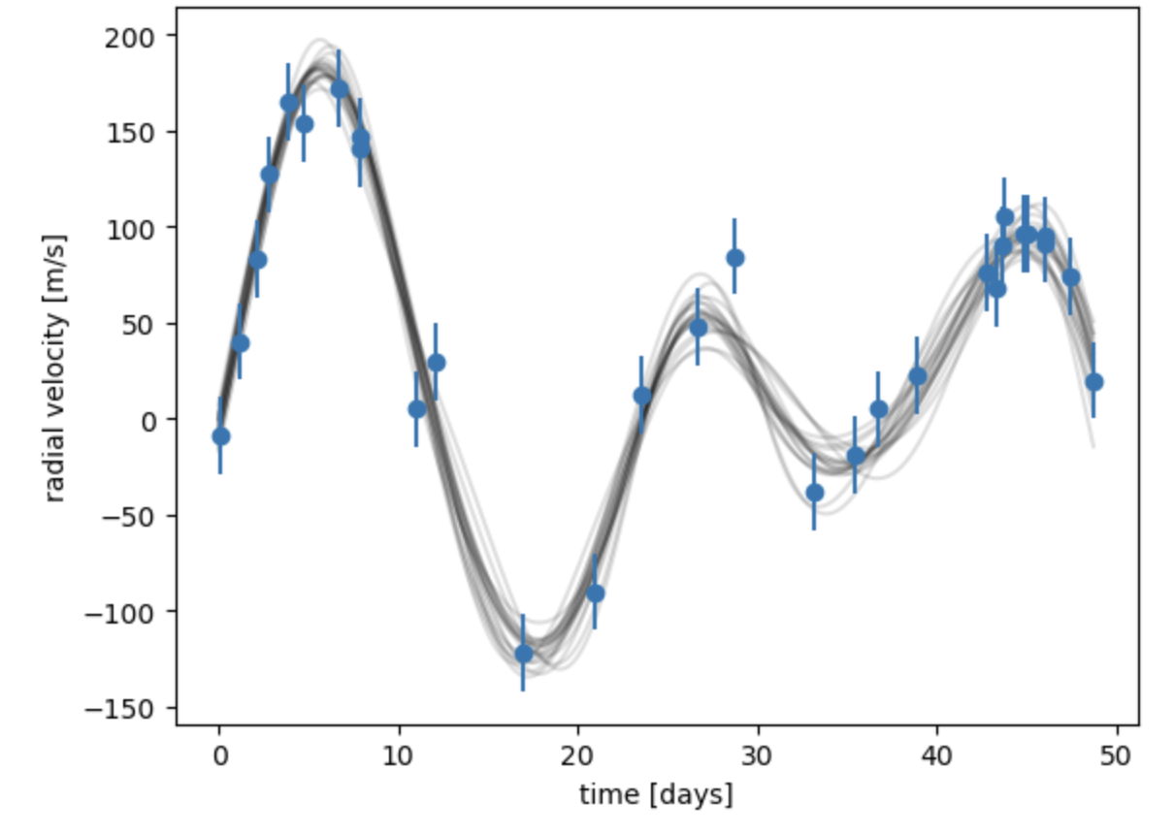
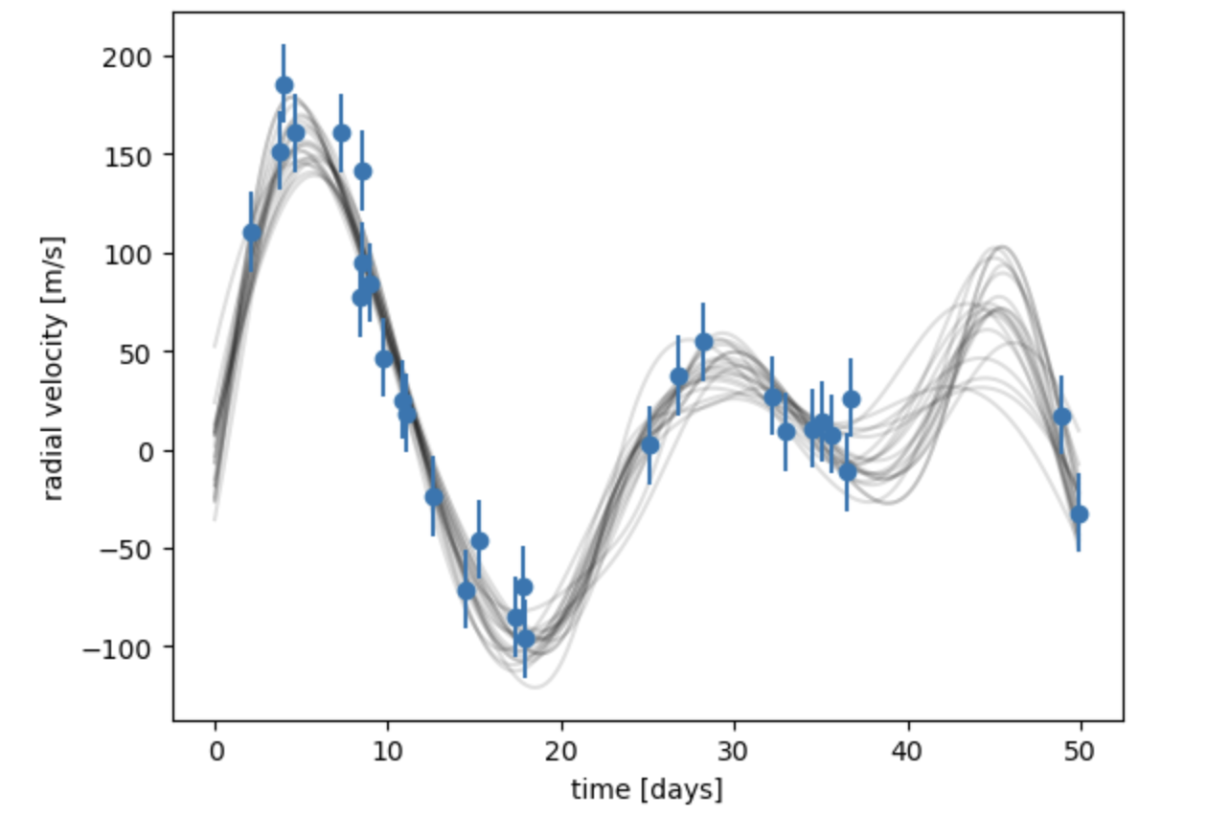
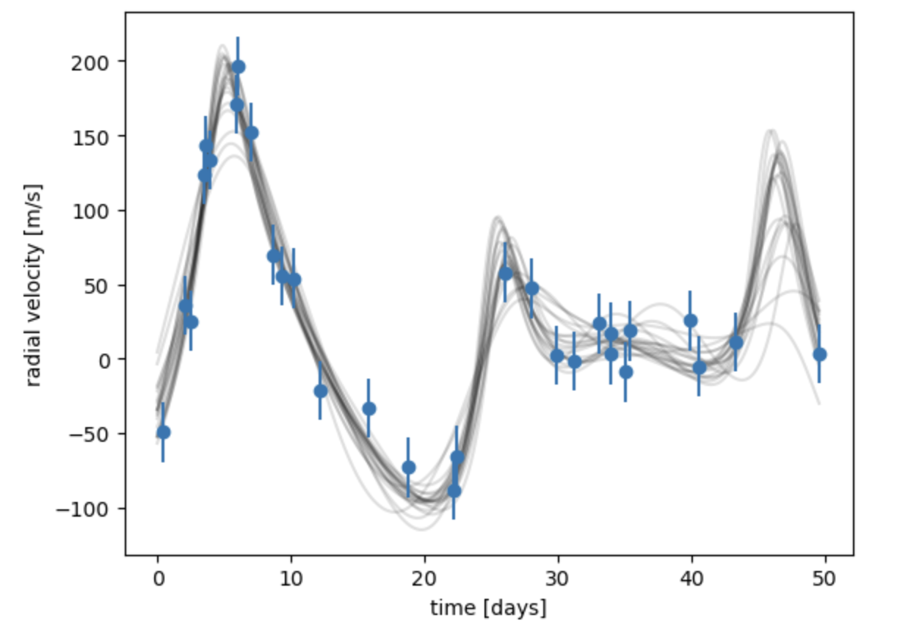
Increasing Eccentricity Planet A
Two planets orbiting
Ms=1
Planet A; M=1e-3 , P=21*60*60*24 ,
h=0.1 , k=0.05
Planet B; M=1e-3 , P=30*60*60*24
h=0.1 , k=0.05
N= 30
Error= 20
Noise=20
Ms=1
Planet A; M=1e-3 , P=21*60*60*24 ,
h=0.2 , k=0.05
Planet B; M=1e-3 , P=30*60*60*24
h=0.1 , k=0.05
N= 30
Error= 20
Noise=20
Ms=1
Planet A; M=1e-3 , P=21*60*60*24 ,
h=0.4 , k=0.05
Planet B; M=1e-3 , P=30*60*60*24
h=0.1 , k=0.05
N= 30
Error= 20
Noise=20
Increasing eccentricity of planet A changes the peaks of the waves.

Slide 8
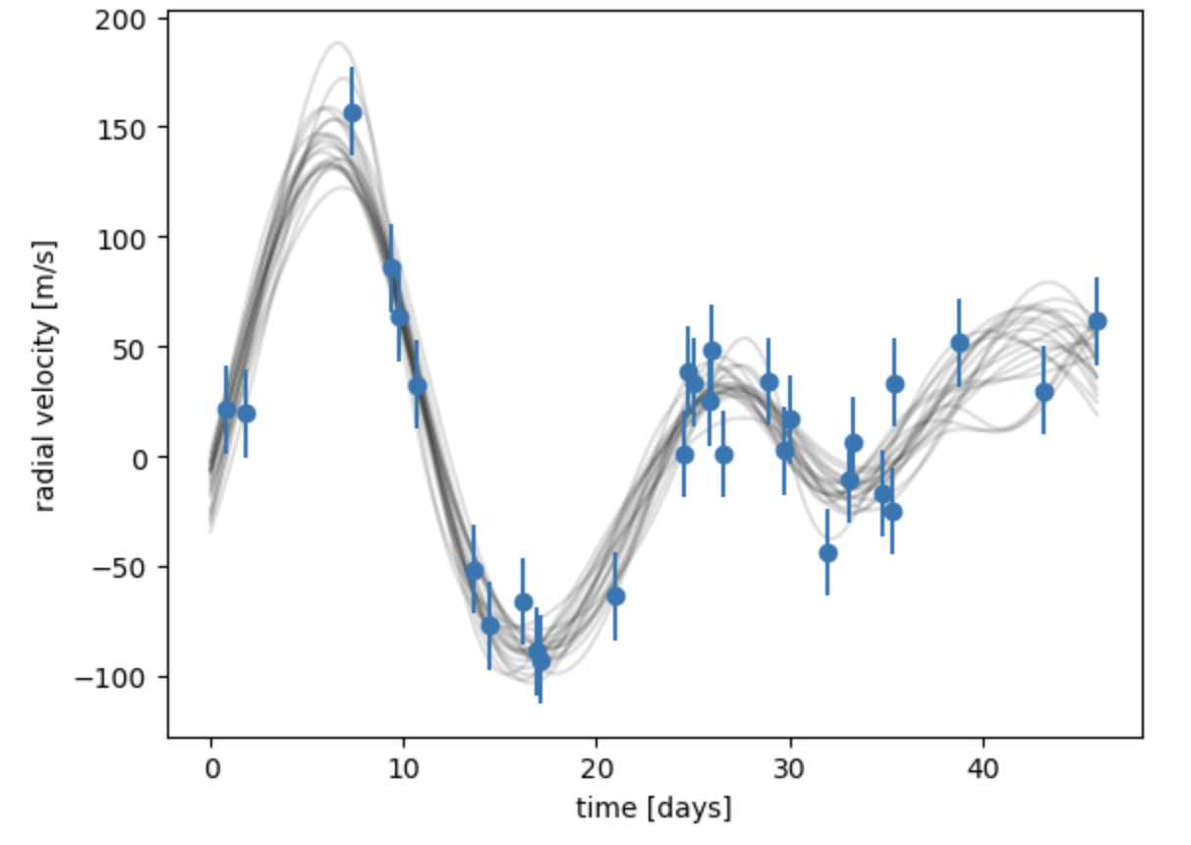
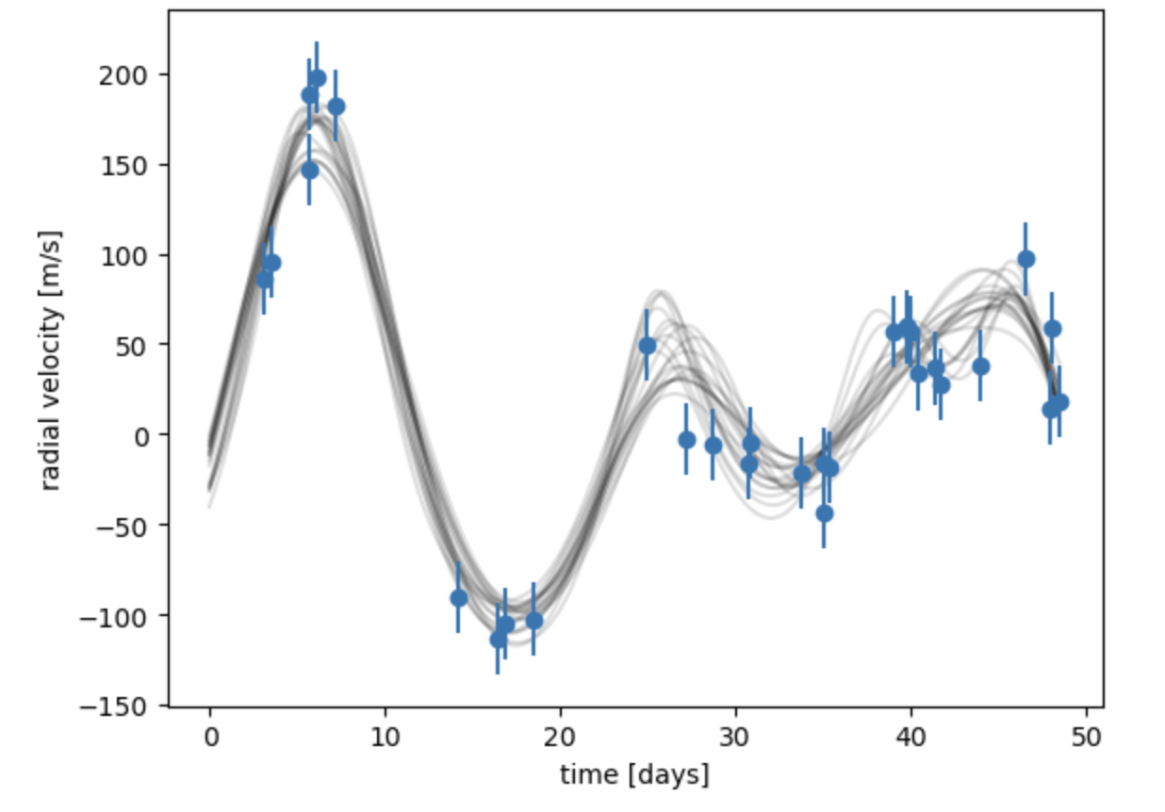
Increasing Eccentricity Planet B
Two planets orbiting
Ms=1
Planet A; M=1e-3 , P=21*60*60*24 ,
h=0.1 , k=0.05
Planet B; M=1e-3 , P=30*60*60*24
h=0.1 , k=0.05
N= 30
Error= 20
Noise=20
Ms=1
Planet A; M=1e-3 , P=21*60*60*24 ,
h=0.1 , k=0.05
Planet B; M=1e-3 , P=30*60*60*24
h=0.2 , k=0.05
N= 30
Error= 20
Noise=20
Ms=1
Planet A; M=1e-3 , P=21*60*60*24 ,
h=0.1 , k=0.05
Planet B; M=1e-3 , P=30*60*60*24
h=0.4 , k=0.05
N= 30
Error= 20
Noise=20
Increasing eccentricity of planet B changes the peaks of the waves.

Slide 9
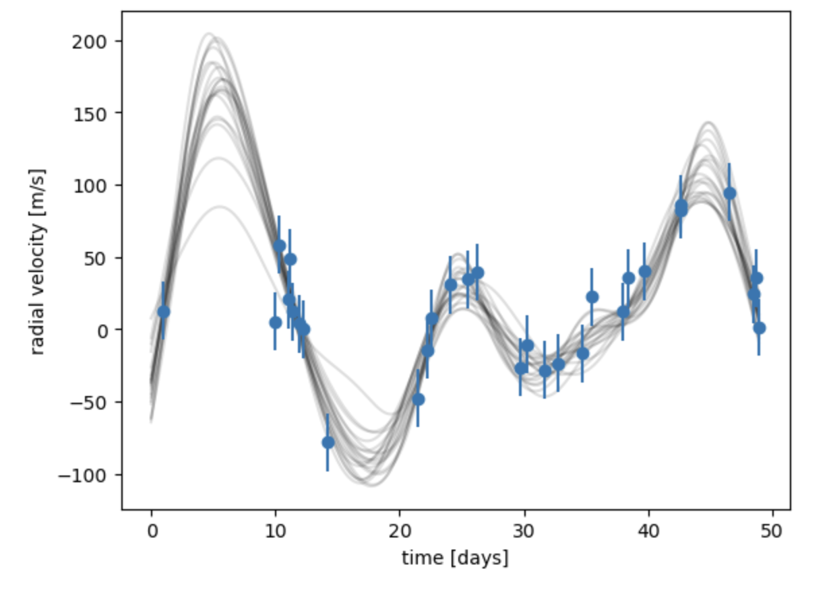
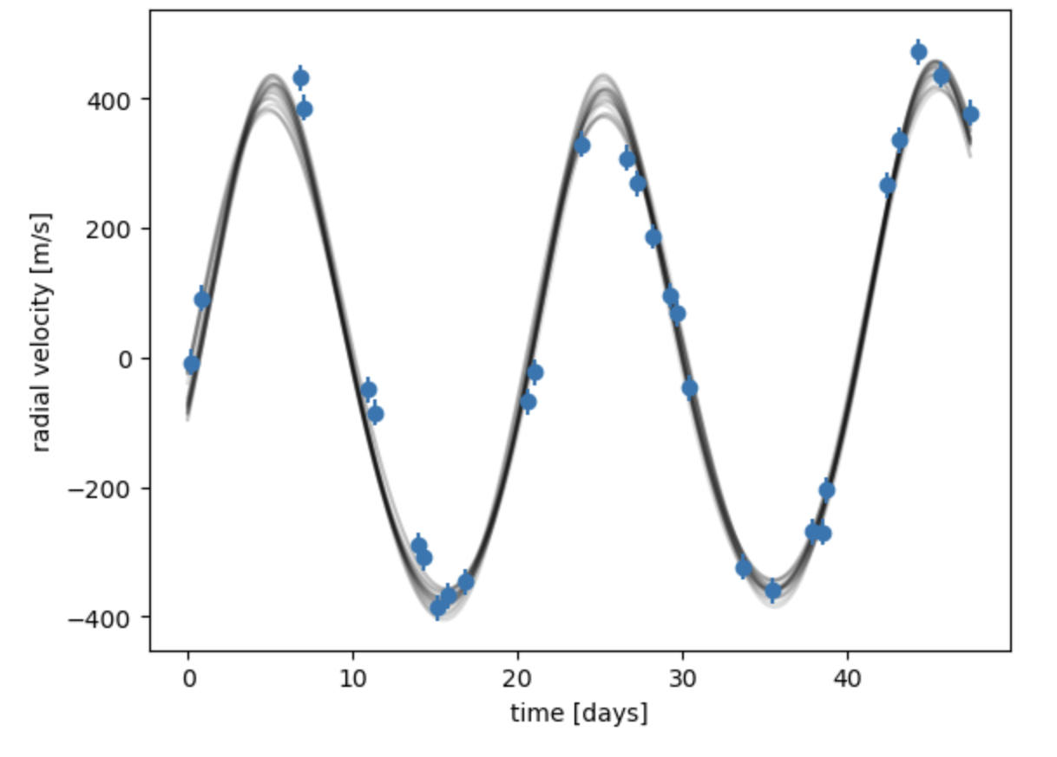
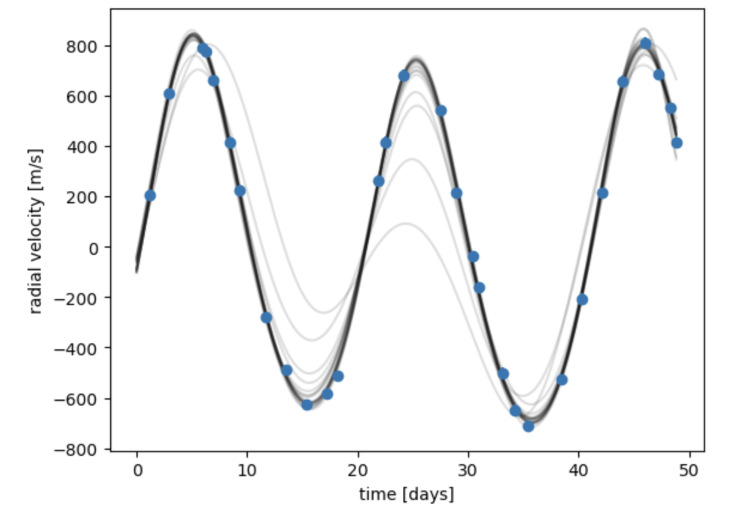
Increasing Mass Planet A
Two planets orbiting
Ms=1
Planet A; M=3e-3 , P=21*60*60*24 ,
h=0.1 , k=0.05
Planet B; M=1e-3 , P=30*60*60*24
h=0.1 , k=0.05
N= 30
Error= 20
Noise=20
Ms=1
Planet A; M=6e-3 , P=21*60*60*24 ,
h=0.1 , k=0.05
Planet B; M=1e-3 , P=30*60*60*24
h=0.1 , k=0.05
N= 30
Error= 20
Noise=20
Ms=1
Planet A; M=9e-3 , P=21*60*60*24 ,
h=0.1 , k=0.05
Planet B; M=1e-3 , P=30*60*60*24
h=0.1 , k=0.05
N= 30
Error= 20
Noise=20
Increasing the Mass of Planet A increases radial velocity-wave acts as if no second planet is in orbit.

Slide 10
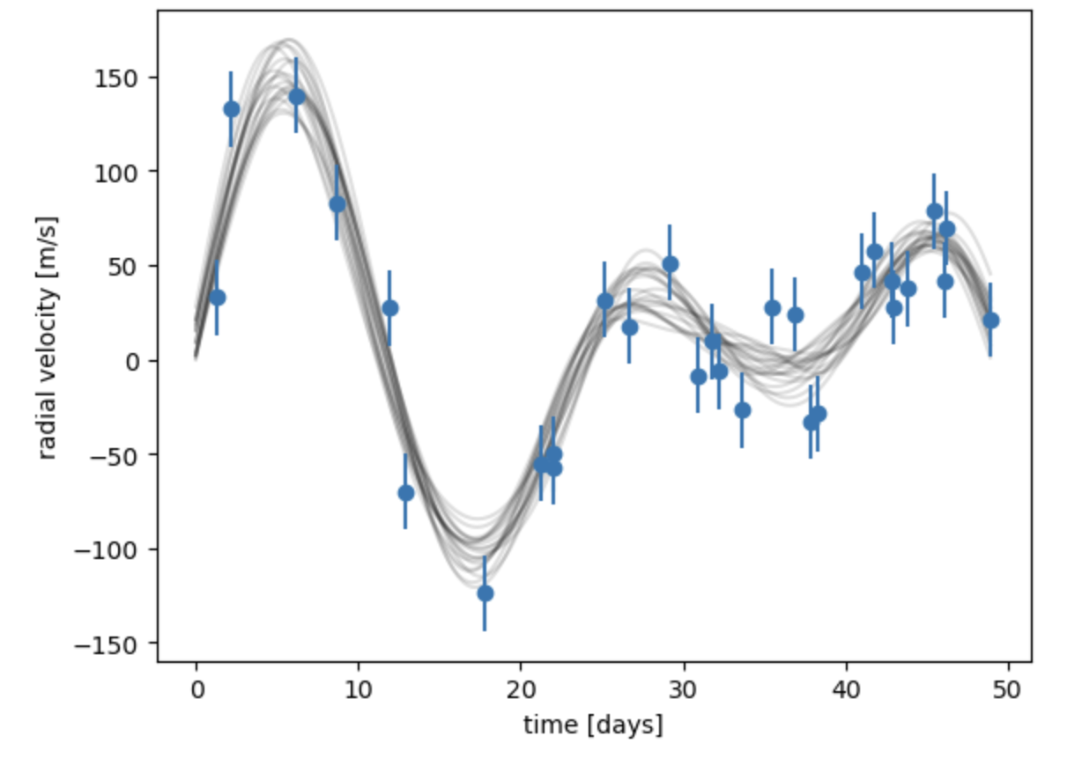
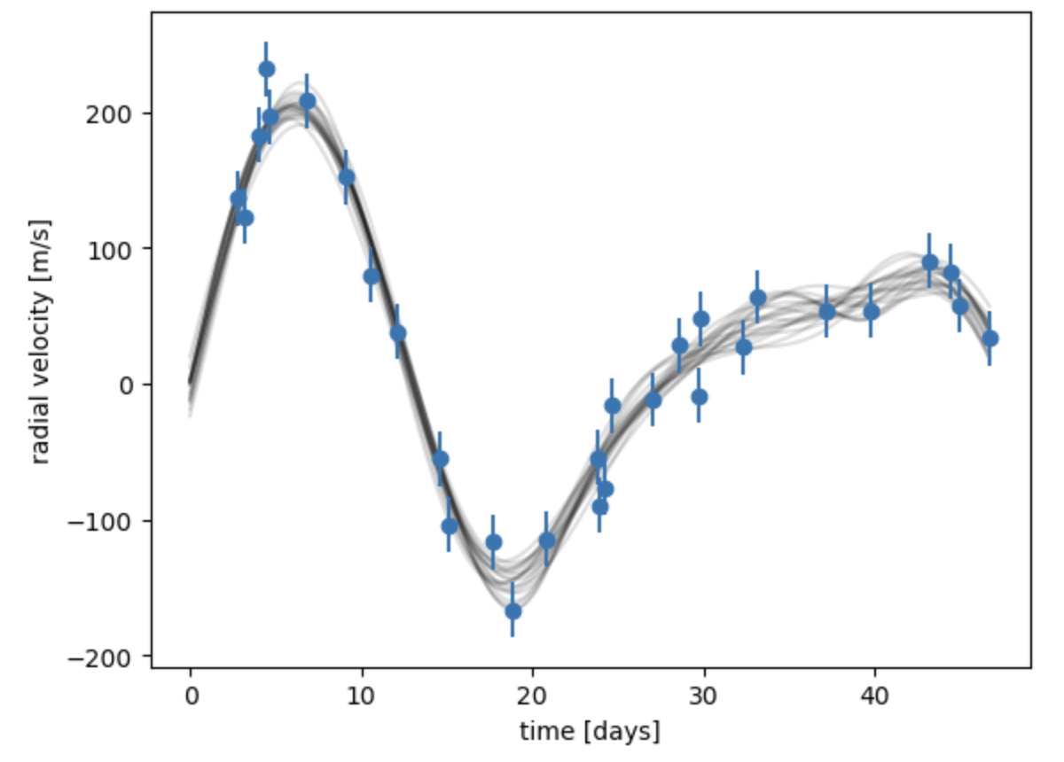
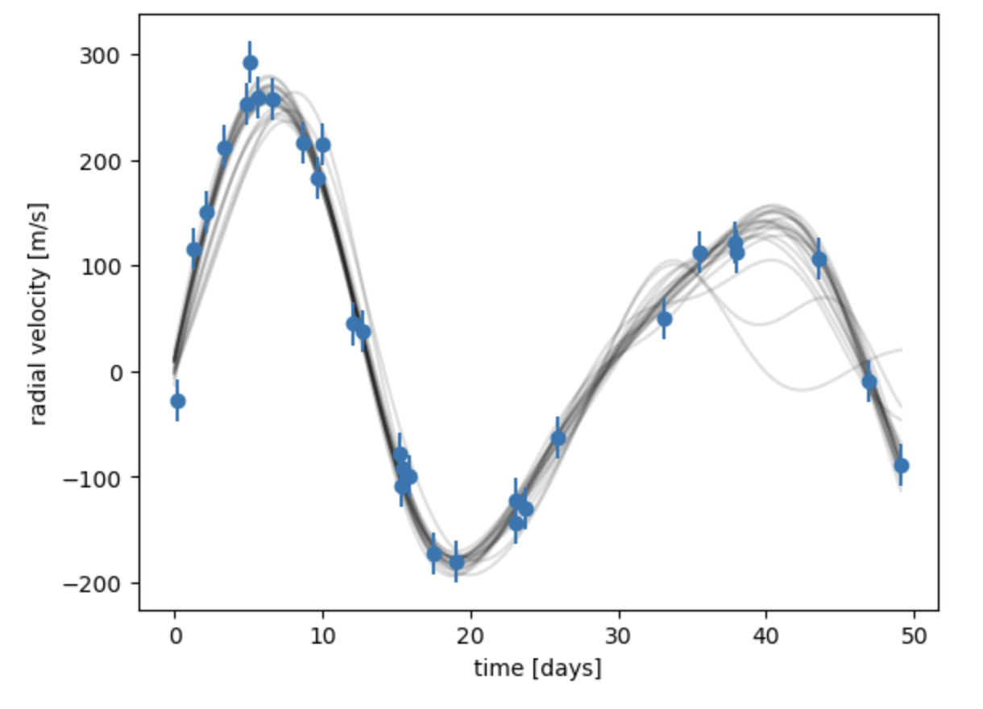
Increasing Mass Planet B
Two planets orbiting
Ms=1
Planet A; M=9e-3 , P=21*60*60*24 ,
h=0.1 , k=0.05
Planet B; M=1e-3 , P=30*60*60*24
h=0.005 , k=0.005
N= 30
Error= 20
Noise=20
Ms=1
Planet A; M=9e-3 , P=21*60*60*24 ,
h=0.1 , k=0.05
Planet B; M=2e-3 , P=30*60*60*24
h=0.005 , k=0.005
N= 30
Error= 20
Noise=20
Ms=1
Planet A; M=9e-3 , P=21*60*60*24 ,
h=0.1 , k=0.05
Planet B; M=3e-3 , P=30*60*60*24
h=0.005 , k=0.005
N= 30
Error= 20
Noise=20
Increasing mass of planet B increases radial velocity.

Slide 11
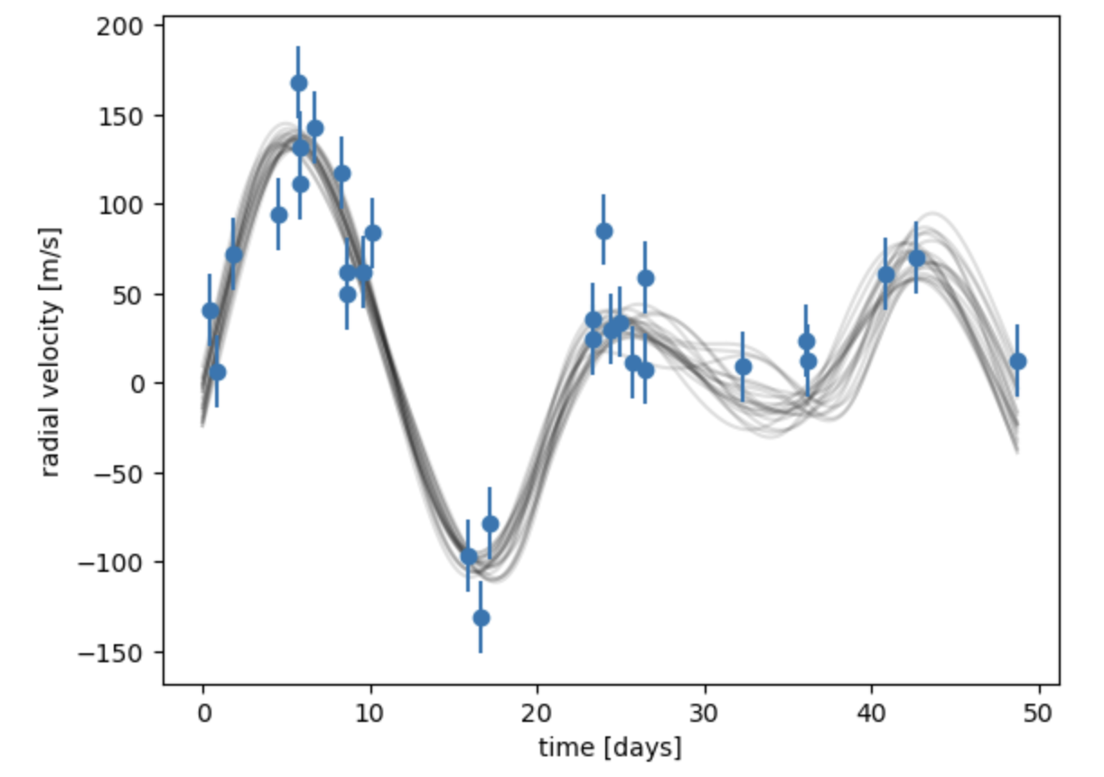
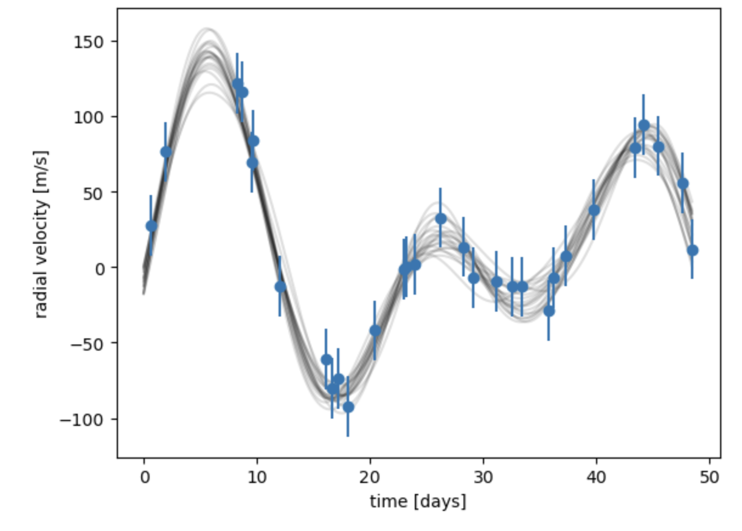
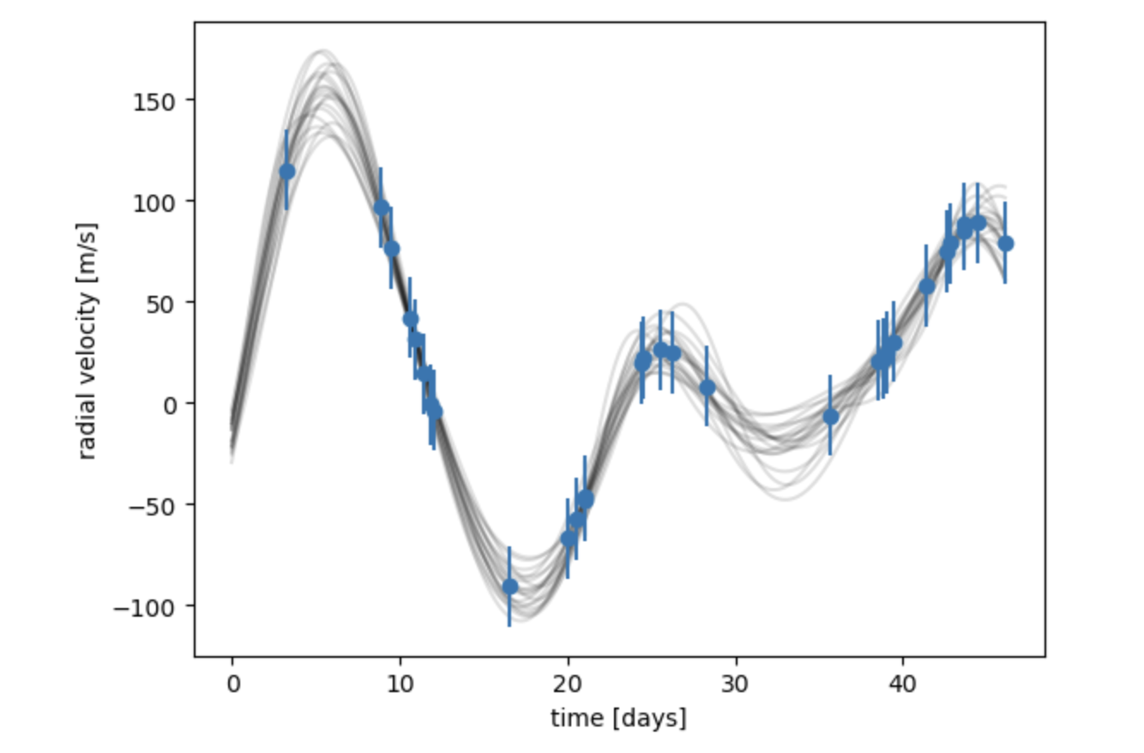
Decreasing Noise
Two planets orbiting
Ms=1
Planet A; M=9e-3 , P=21*60*60*24 ,
h=0.1 , k=0.05
Planet B; M=1e-3 , P=30*60*60*24
h=0.005 , k=0.005
N= 30
Error= 20
Noise=25
Ms=1
Planet A; M=9e-3 , P=21*60*60*24 ,
h=0.1 , k=0.05
Planet B; M=1e-3 , P=30*60*60*24
h=0.005 , k=0.005
N= 30
Error= 20
Noise=12
Ms=1
Planet A; M=9e-3 , P=21*60*60*24 ,
h=0.1 , k=0.05
Planet B; M=1e-3 , P=30*60*60*24
h=0.005 , k=0.005
N= 30
Error= 20
Noise=1
Decreasing noise forms a clearer wave.

Slide 12
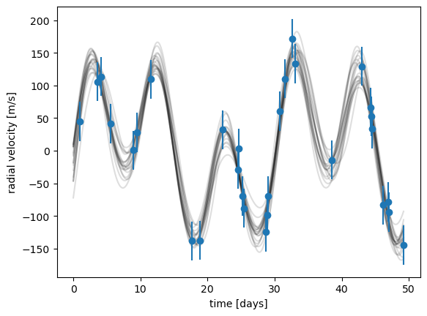
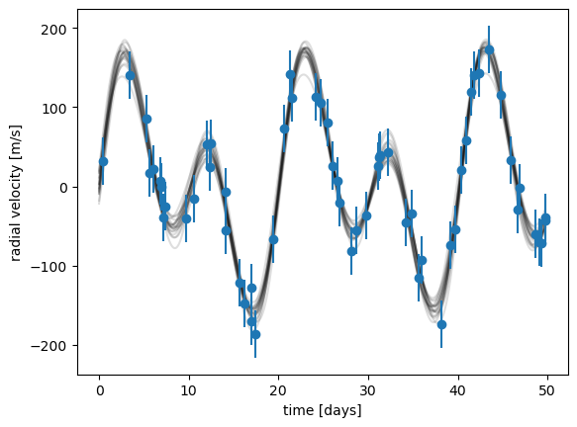
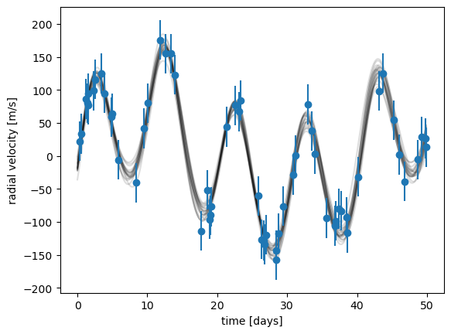
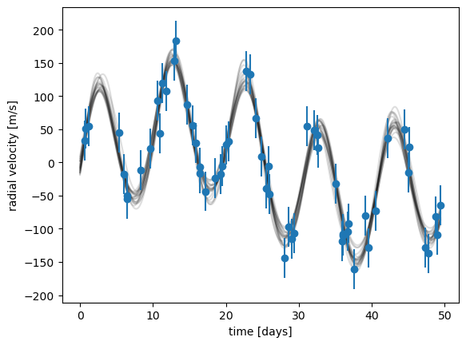
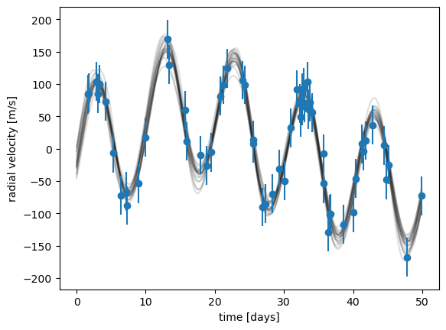
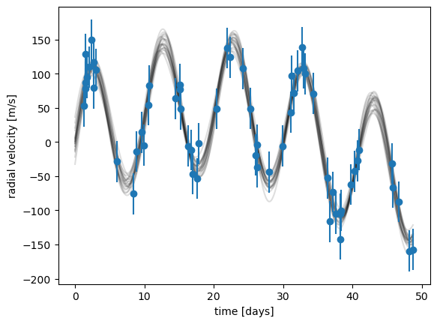
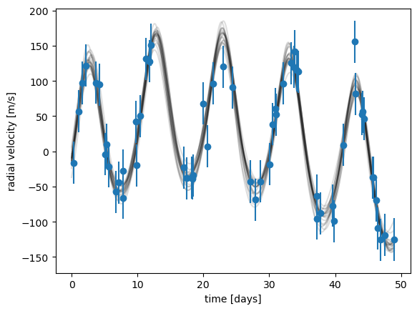
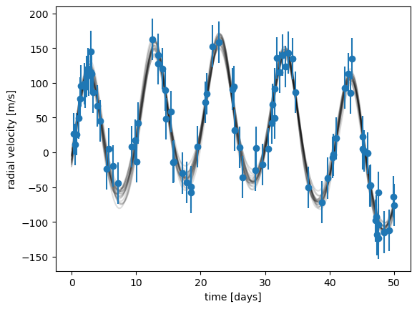
Increasing Orbital Period A
Two planets orbiting
Planet A; M=1e-3 , h=0.05 , k=0.01 Error=30
Planet B; M=1e-3 , h=0.05 , k=0.01 Noise=20
Note; as orbital period increases N must increase
Pa= 20*60*60*24
Pb= 10*60*60*24
N=30
Pa= 30*60*60*24
Pb= 10*60*60*24
N=60
Pa= 40*60*60*24
Pb= 10*60*60*24
N=60
Pa= 50*60*60*24
Pb= 10*60*60*24
N=60
Pa= 60*60*60*24
Pb= 10*60*60*24
N=60
Pa= 70*60*60*24
Pb= 10*60*60*24
N=90
Pa= 80*60*60*24
Pb= 10*60*60*24
N=90
Pa= 90*60*60*24
Pb= 10*60*60*24
N=90
As the orbital period increases, the amplitude increases until it appears as though only one planet is in orbit.

Slide 13
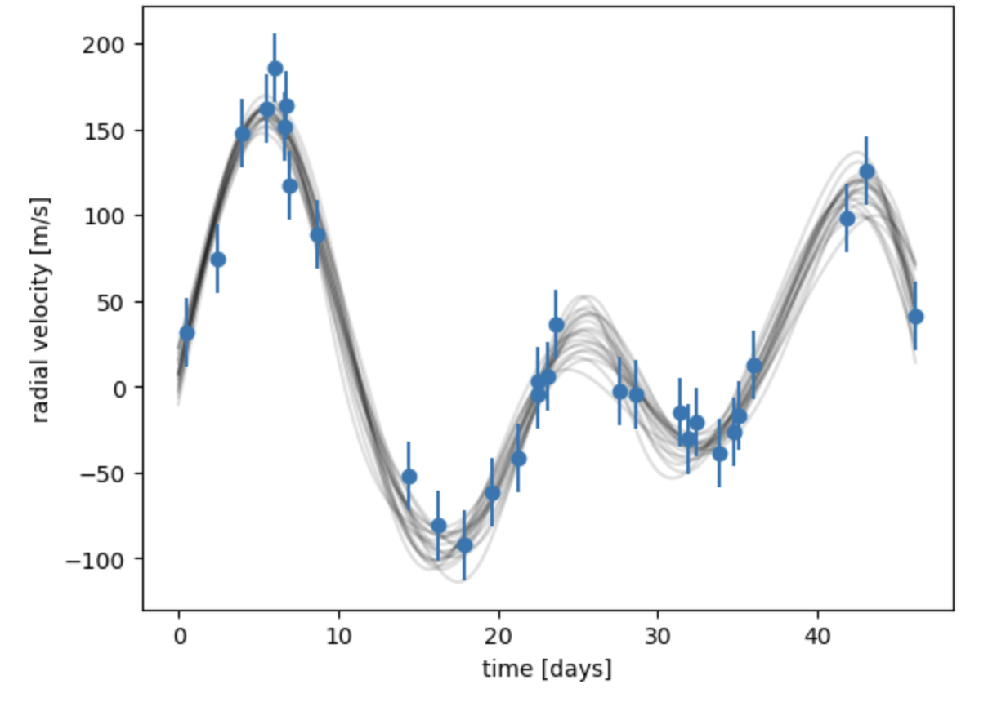
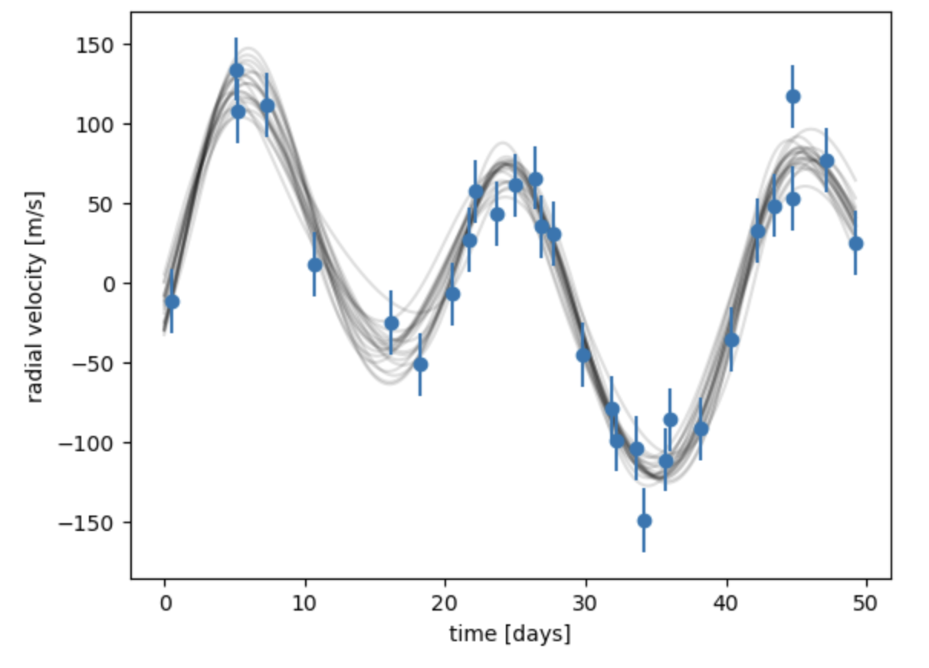
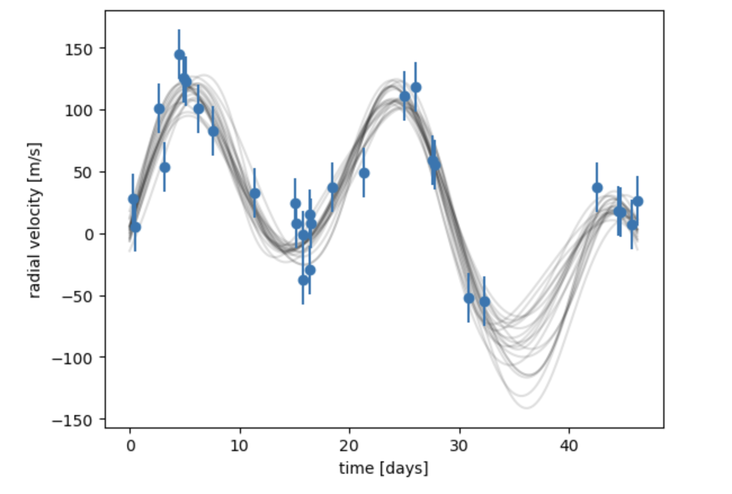
Increasing Orbital Period Planet B
Two planets orbiting
Ms=1
Planet A; M=9e-3 , P=21*60*60*24 ,
h=0.1 , k=0.05
Planet B; M=1e-3 , P=30*60*60*24
h=0.005 , k=0.005
N= 30
Error= 20
Noise=20
Ms=1
Planet A; M=9e-3 , P=21*60*60*24 ,
h=0.1 , k=0.05
Planet B; M=1e-3 , P=45*60*60*24
h=0.005 , k=0.005
N= 30
Error= 20
Noise=20
Ms=1
Planet A; M=9e-3 , P=21*60*60*24 ,
h=0.1 , k=0.05
Planet B; M=1e-3 , P=60*60*60*24
h=0.005 , k=0.005
N= 30
Error= 20
Noise=20
Increasing Orbital Velocity of Planet B decreases overall radial velocity.

Slide 14
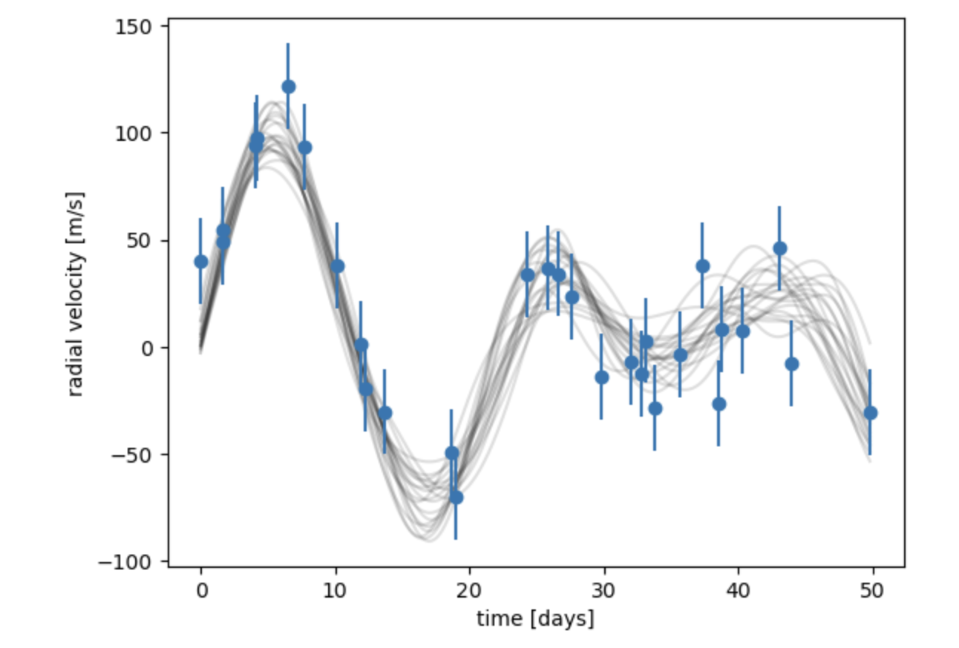
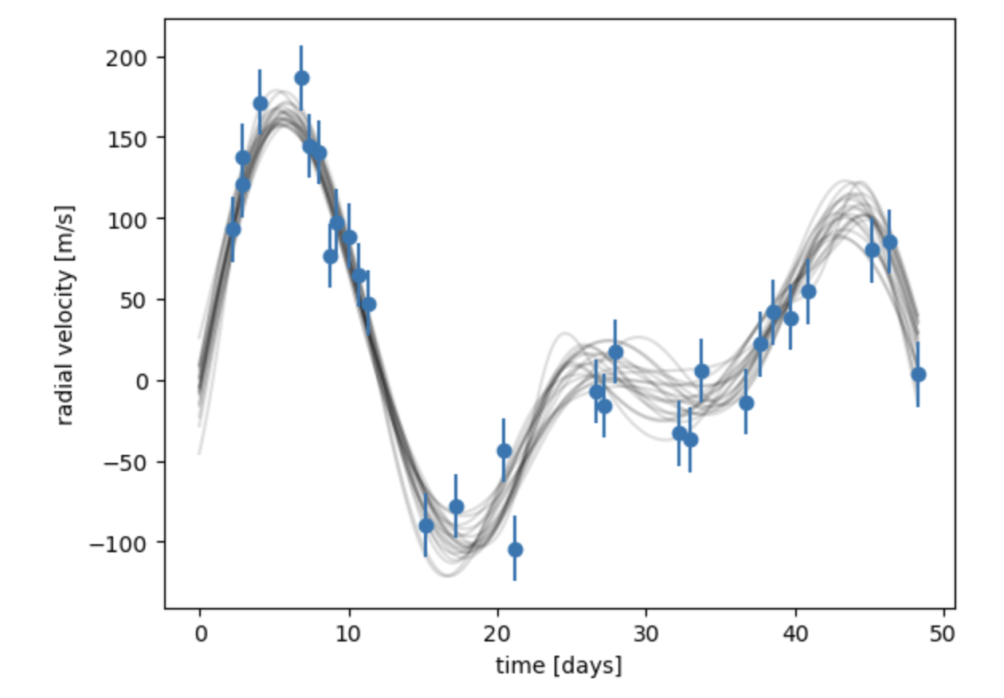
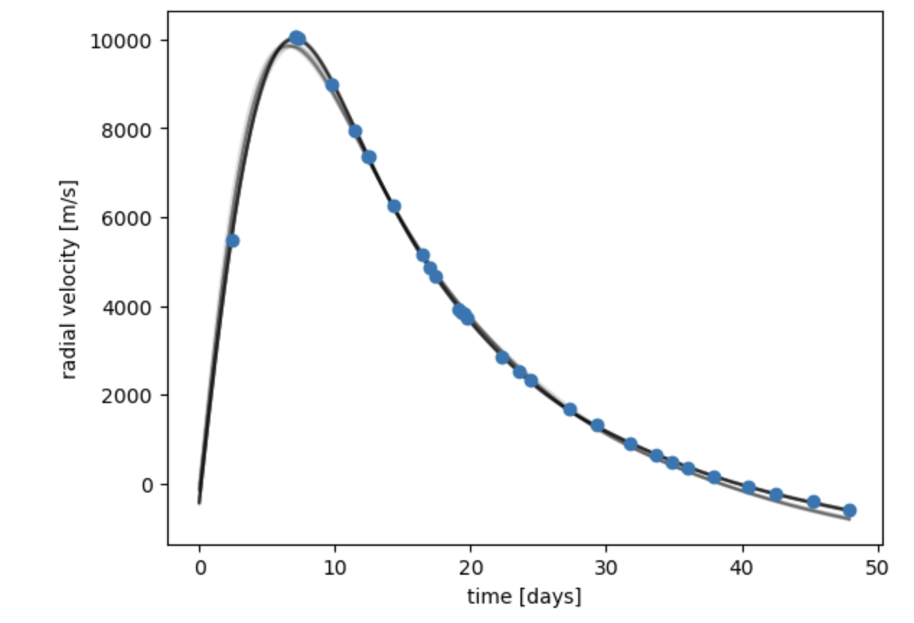
Decreasing Mass of Star
Two planets orbiting
Ms=2
Planet A; M=9e-3 , P=21*60*60*24 ,
h=0.1 , k=0.05
Planet B; M=1e-3 , P=30*60*60*24
h=0.005 , k=0.005
N= 30
Error= 20
Noise=20
Ms=1
Planet A; M=9e-3 , P=21*60*60*24 ,
h=0.1 , k=0.05
Planet B; M=1e-3 , P=30*60*60*24
h=0.005 , k=0.005
N= 30
Error= 20
Noise=20
Ms=0
Planet A; M=9e-3 , P=21*60*60*24 ,
h=0.1 , k=0.05
Planet B; M=1e-3 , P=30*60*60*24
h=0.005 , k=0.005
N= 30
Error= 20
Noise=20
Decreasing mass of star increases radial velocity- Ms=0 is an error in the code.

